Slide 1
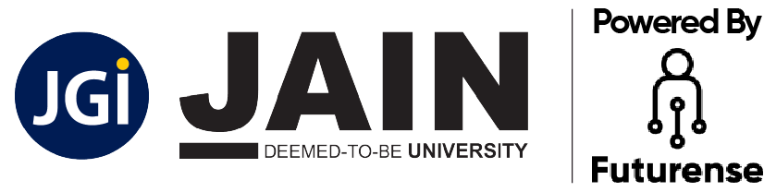
Revolutionising B.Tech

Slide 2


COMPUTER NETWORKS
Course Code: 22CSE103
MODULE - III
Dr Kranthi Ph.D., M. Tech (CSE), M. Tech (IT), MISTE, MCSI, MIAENG, MIFERP
Associate Professor, Department of CSE, FET
JAIN (Deemed-to-be University), Bangalore, India.
Email: kranthi.kumar@jainuniversity.ac.in
Phone: 7972677739
4 July 2023

Slide 3
Table of Contents
4.1.1 Transport Layer Service
* Services provided to the upper layers
* Transport service primitives
* Introduction to socket programming
4.2.1 Elements of transport protocols
* Addressing
* Shortest path routing, flooding
* Connection establishment
* Connection release
* Error control and flow control
* Multiplexing and crash recovery
4.3.1 The internet transport protocols : UDP
* Introduction to UDP
* Remote procedure call
* Real-time transport protocols
4.4.1 The internet transport protocols : TCP
* Introduction to TCP
* TCP service model, protocol, segment header
4.4.2 The connection management
* TCP connection management and release
* TCP sliding window and timer management
* TCP congestion control

Slide 4

Aim
The aim of the transport layer module in computer networks is to introduce students to the concepts and functionalities provided by the transport layer protocol. The transport layer is the fourth layer of the OSI model and is responsible for the end-to-end delivery of data between hosts in a network.

Slide 5

Students will learn about the purpose and significance of the transport layer in the network stack. They will understand how it enables reliable communication and provides various services to the upper layers.
Students will be introduced to popular transport layer protocols such as Transmission Control Protocol (TCP) and User Datagram Protocol (UDP). They will learn about their differences, advantages, and use cases.
Students will understand the distinction between connection-oriented protocols like TCP, which establish a reliable, ordered, and error-checked connection, and connectionless protocols like UDP, which provide a simple best-effort delivery service.
Students will learn about the mechanisms employed by transport layer protocols to ensure reliable data delivery, including sequence numbers, acknowledgments, and retransmissions.
Students will be introduced to flow control and congestion control mechanisms used by transport layer protocols to regulate the flow of data and prevent network congestion.
Students will understand how the transport layer supports multiple applications running simultaneously on a single host using port numbers for multiplexing and demultiplexing data.
Students will have an opportunity to learn about socket programming, which allows applications to communicate over the network using the transport layer protocols. They will gain hands-on experience in writing client-server applications using TCP or UDP sockets.
Objective

Slide 6
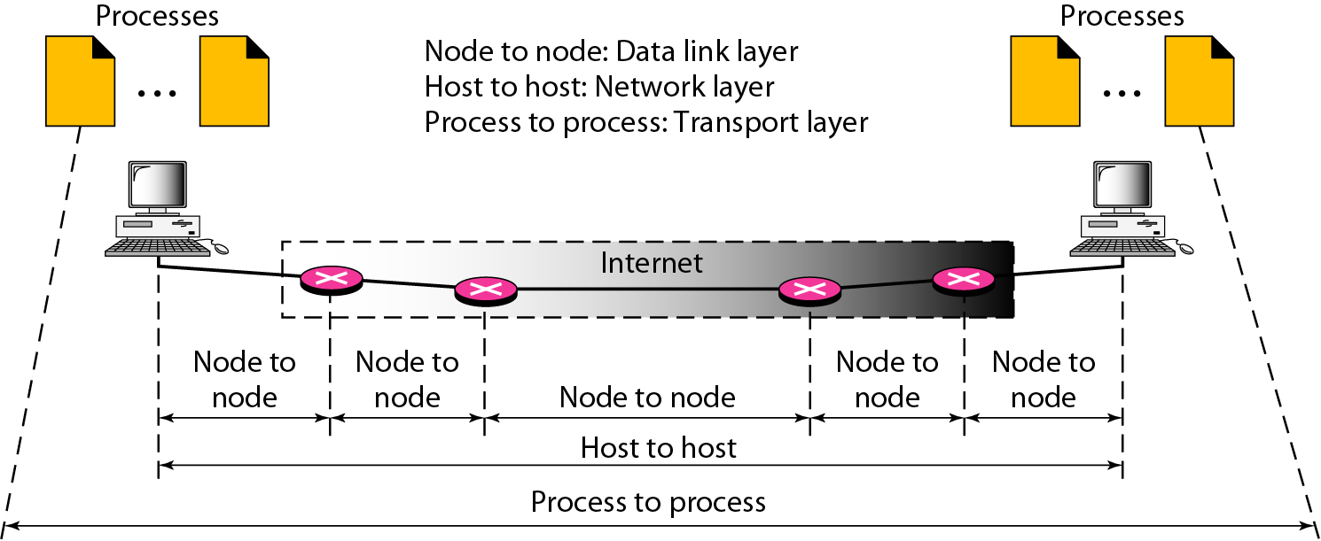
4.1 Transport Layer: Introduction - Services
Transport layer is the heart of the whole protocol hierarchy. Transport layer task is to provide reliable, cost-effective data transport from the source machine to the destination machine, independently of the physical network or networks currently in use.
Process-To-Process Delivery: Several processes may be running on the source host and several on the destination host. To complete the delivery, we need a mechanism to deliver data from one of these processes running on the source host to the corresponding process running on the destination host. That mechanism is called " Process- Process Delivery".
Two processes communicate in a client/server relationship.
Client-Server Paradigm:
A process on the local host, called a client, needs services from a process usually on the remote host, called a server.

Slide 7
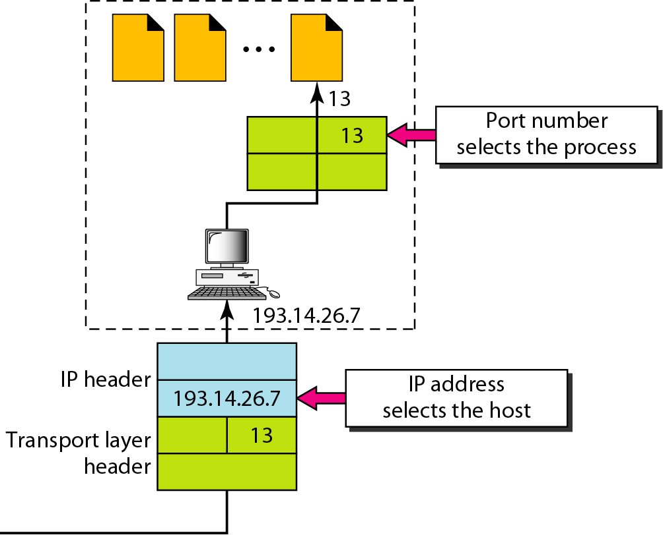
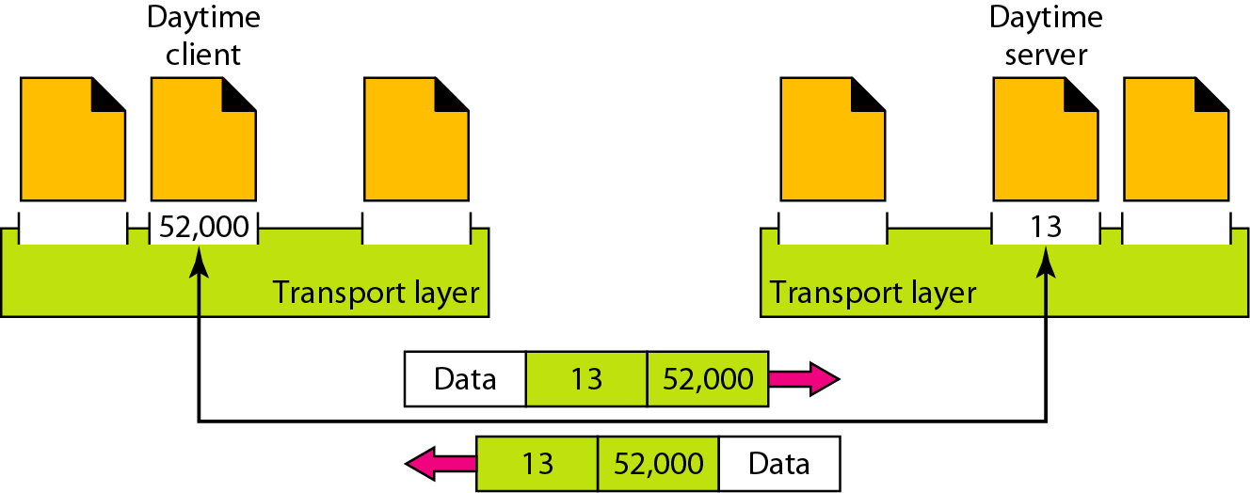
4.1 Transport Layer: Introduction - Services
Addressing: The address at the transport layer is called " Service-Point address" or " Port Address". If the network model is OSI, then it is called " Service- Point address". If the network model is TCP/IP it is called " Port Address". The port numbers are 16-bit integers between 0 and 65,535.
The client program defines itself with a port number, chosen randomly by the transport layer software running on the client host. This is the Ephemeral Port Number.
The server process must also define itself with a port number. This port number, cannot be chosen randomly. This is called " Well-Known Port Number".
Figure: Port Addresses
Figure: Relation Between IP address and Port address

Slide 8
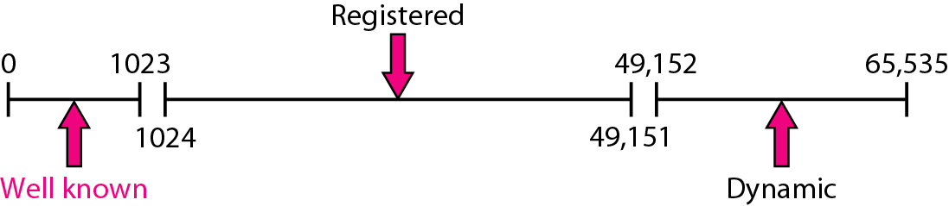
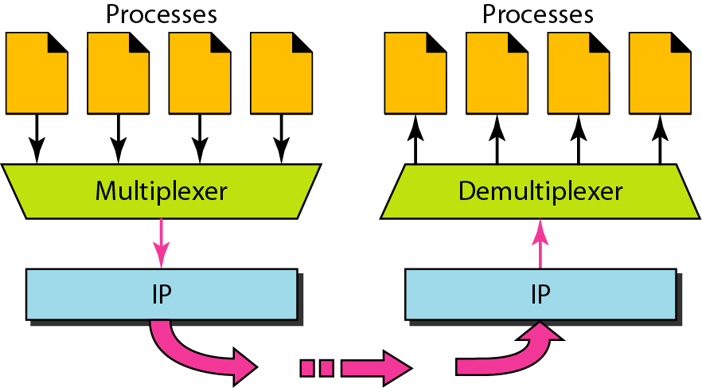
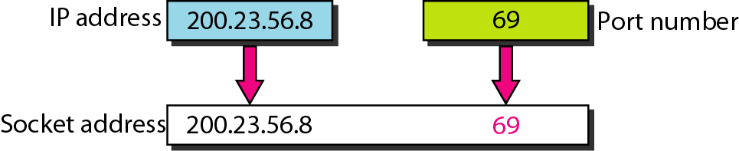
4.1 Transport Layer: Introduction - Services
IANA Ranges of Port Numbers: The lANA (Internet Assigned Number Authority) has divided the port numbers into three ranges: well known, registered, and dynamic (or private), as shown in Figure.
Well-known ports: The ports ranging from 0 to 1023 are assigned and controlled by IANA. These are the well-known ports.
Registered ports: IANA does not assign or control ports ranging from 1024 to 49,151. They can only be registered with lANA to prevent duplication.
Dynamic ports: The ports ranging from 49,152 to 65,535 are neither controlled nor registered. They can be used by any process. These are the ephemeral ports.
Socket Address: Process-to-process delivery needs two identifiers, the IP address and the port number, at each end to make a connection. An IP address and a port number combination is called a Socket Address. A transport layer protocol needs a pair of socket addresses: the client and server socket addresses.
Multiplexing: At the sender site, several processes may need to send packets. However, there is only one transport layer protocol at any time. This is a many-to-one relationship and requires multiplexing.
Demultiplexing: At the receiver site, the relationship is one-to-many and requires Demultiplexing. The transport layer receives datagrams from the network layer. After error checking and dropping of the header, the transport layer delivers each message to the appropriate process based on the port number.
Figure: IANA ranges for Port numbers.
Figure: Socket Address

Slide 9
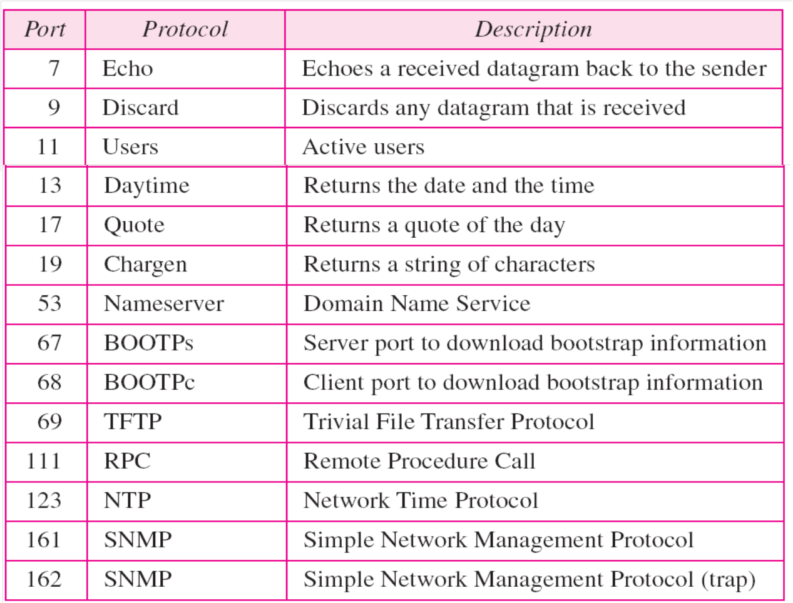
4.1 Transport Layer: Introduction - Services
Connectionless Versus Connection-Oriented Service: A transport layer protocol can either be connectionless or connection-oriented.
Connectionless Service: In a connectionless service, the packets are sent from one party to another with no need for connection establishment or connection release.
The packets are not numbered
The packets may be delayed or lost or may arrive out of sequence.
There is no acknowledgment either. Ex: UDP
Connection-Oriented Service: In a connection-oriented service, a connection is first established between the sender and the receiver. Data are transferred. At the end, the connection is released. Ex: TCP and SCTP
UDP (User Datagram Protocol): The User Datagram Protocol (UDP) is called a connectionless, unreliable transport protocol. It does not add anything to the services of IP except to provide process-to-process communication instead of host-to-host communication. It performs very limited error checking.
Table: Well-known port numbers for UDP

Slide 10
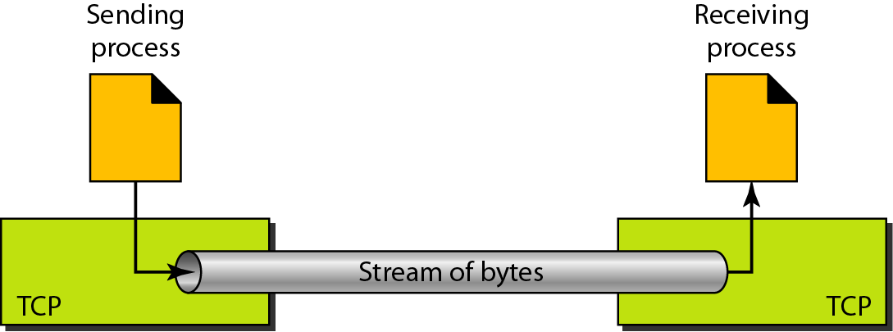
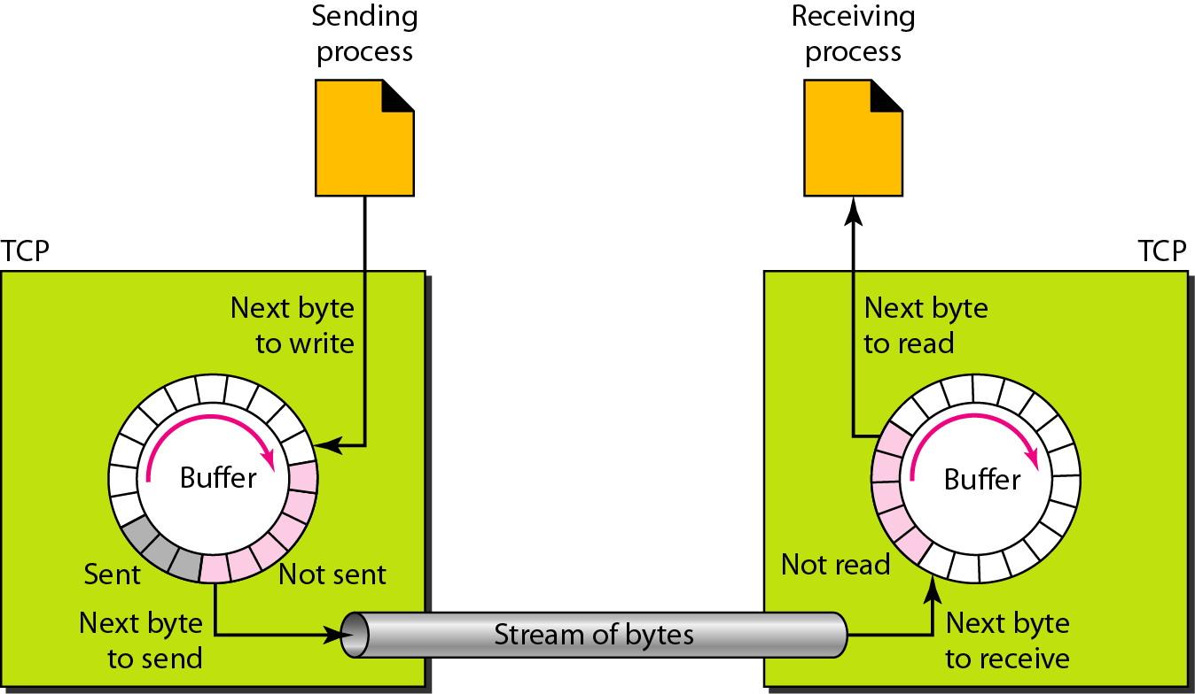
4.1 Transport Layer: Introduction - Services
TCP (Transmission Control Protocol): TCP is called a connection-oriented, reliable transport protocol. It adds connection-oriented and reliability features to the services of IP.
Services Provided by TCP:
Besides to the transport layer services the TCP Protocol provide Stream delivery Service and Source and Destination Buffers
Stream Delivery Service:
TCP is a stream-oriented protocol.
TCP allows the sending process to deliver data as a stream of bytes and allows the receiving process to obtain data as a stream of bytes.
TCP creates an environment in which the two processes seem to be connected by an imaginary "tube" that carries their data across the Internet.
The sending process produces (writes to) the stream of bytes, and the receiving process consumes (reads from) them.
Figure: Stream Delivery
Source and Destination Buffers: Sending and Receiving Buffers Because the sending and the receiving processes may not write or read data at the same speed, TCP needs buffers for storage. There are two buffers, the sending buffer and the receiving buffer, one for each direction.
Figure: Sending and Receiving Buffers

Slide 11
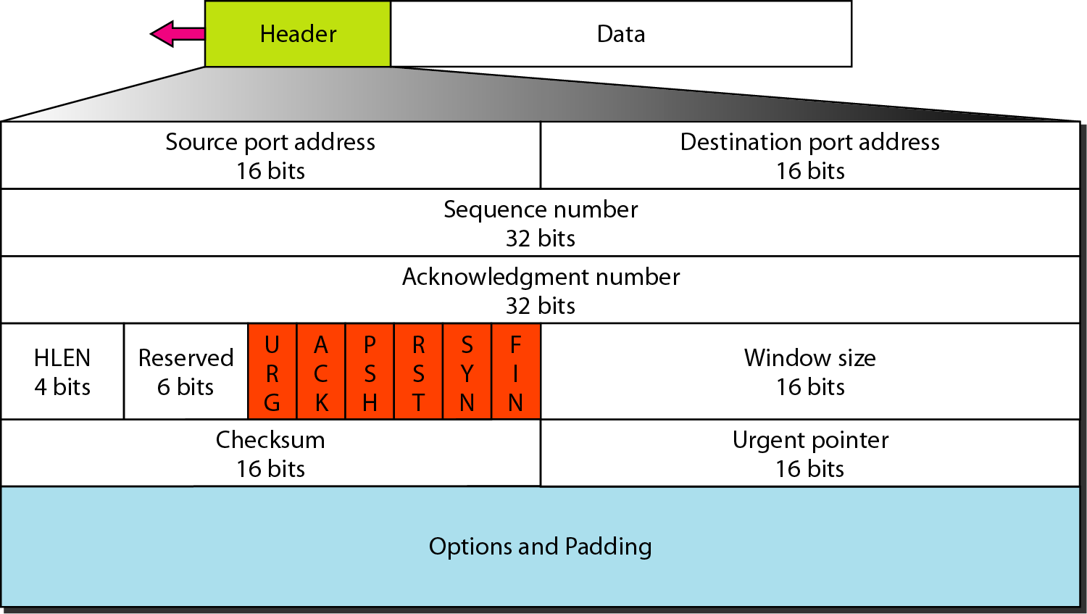
4.1 Transport Layer: Introduction - Services
Figure: TCP Segment Format
Source port address: This is a 16-bit field that defines the port number of the application program in the host that is sending the segment.
Destination port address: This is a 16-bit field that defines the port number of the application program in the host that is receiving the segment.
Well Known Port numbers
TCP Segment Format: The segment consists of a 20- to 60-byte header, followed by data from the application program. The header is 20 bytes if there are no options and up to 60 bytes if it contains options.

Slide 12
4.1 Transport Layer: Introduction - Services
Sequence number: This 32-bit field defines the number assigned to the first byte of data contained in this segment. TCP is a stream transport protocol. To ensure connectivity, each byte to be transmitted is numbered. The sequence number tells the destination which byte in this sequence comprises the first byte in the segment.
Acknowledgment number: This 32-bit field defines the byte number that the receiver of the segment is expecting to receive from the other party. If the receiver of the segment has successfully received byte number x from the other party, it defines x +1 as the acknowledgment number. Acknowledgment and data can be piggybacked together.
Header length: This 4-bit field indicates the number of 4-byte words in the TCP header. The length of the header can be between 20 and 60 bytes. Therefore, the value of this field can be between 5 (5 x 4 =20) and 15 (15 x 4 =60).
Reserved: This is a 6-bit field reserved for future use.
Control: This field defines 6 different control bits or flags. One or more of these bits can be set at a time.
Figure: Description of the flags in Control field
Window size: This field defines the size of the window, in bytes, that the other party must maintain. This value is normally referred to as the receiving window (rwnd) and is determined by the receiver. The sender must obey the dictation of the receiver in this case.
Checksum: This 16-bit field contains the checksum. This is used to detect errors in the header.
Urgent pointer: This l6-bit field, which is valid only if the urgent flag is set, is used when the segment contains urgent data. It defines the number that must be added to the sequence number to obtain the number of the last urgent byte in the data section of the segment. This will be discussed later in this chapter.
Options: There can be up to 40 bytes of optional information in the TCP header.

Slide 13
4.1 Transport Layer: Introduction - Services
TCP Connection Management: TCP is connection-oriented. A connection-oriented transport protocol establishes a virtual path between the source and destination. All the segments belonging to a message are then sent over this virtual path. Using a single virtual pathway for the entire message facilitates the acknowledgment process as well as retransmission of damaged or lost frames. The point is that a TCP connection is virtual, not physical. TCP operates at a higher level. TCP uses the services of IP to deliver individual segments to the receiver, but it controls the connection itself. If a segment is lost or corrupted, it is retransmitted. Unlike TCP, IP is unaware of this retransmission. If a segment arrives out of order, TCP holds it until the missing segments arrive; IP is unaware of this reordering.
In TCP, connection-oriented transmission requires three phases:
Connection Establishment,
Data Transfer, and
Connection Termination.
Connection Establishment: TCP transmits data in full-duplex mode. When two TCPs in two machines are connected, they are able to send segments to each other simultaneously. This implies that each party must initialize communication and get approval from the other party before any data are transferred.
Three-Way Handshaking : The connection establishment in TCP is called three way handshaking. An application program, called the client, wants to make a connection with another application program, called the server, using TCP as the transport layer protocol. The process starts with the server. The server program tells its TCP that it is ready to accept a connection. This is called a request for a passive open. Although the server. TCP is ready to accept any connection from any machine in the world, it cannot make the connection itself. The client program issues a request for an active open. A client that wishes to connect to an open server tells its TCP that it needs to be connected to that particular server. TCP can now start the three-way handshaking process as shown in Figure.
Each segment has values for all its header fields and perhaps for some of its option fields, too.

Slide 14
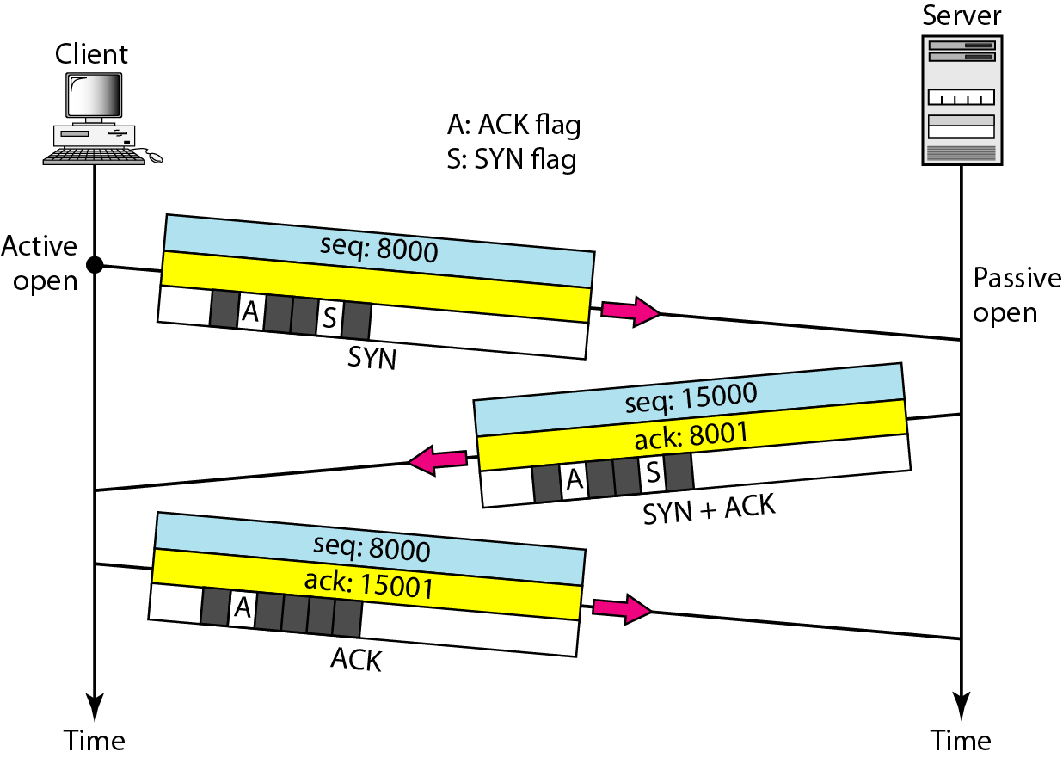
4.1 Transport Layer: Introduction - Services
The client sends the first segment, a SYN segment, in which only the SYN flag is set. This segment is for synchronization of sequence numbers. It consumes one sequence number. When the data transfer starts, the sequence number is incremented by 1. The SYN segment carries no real data.
The server sends the second segment, a SYN +ACK segment, with 2 flag bits set: SYN and ACK. This segment has a dual purpose. It is a SYN segment for communication in the other direction and serves as the acknowledgment for the SYN segment. It consumes one sequence number.
The client sends the third segment. This is just an ACK segment. It acknowledges the receipt of the second segment with the ACK flag and acknowledgment number field. Note that the sequence number in this segment is the same as the one in the SYN segment; the ACK segment does not consume any sequence numbers.
Figure: Three-way handshake protocol for connection establishment in TCP

Slide 15
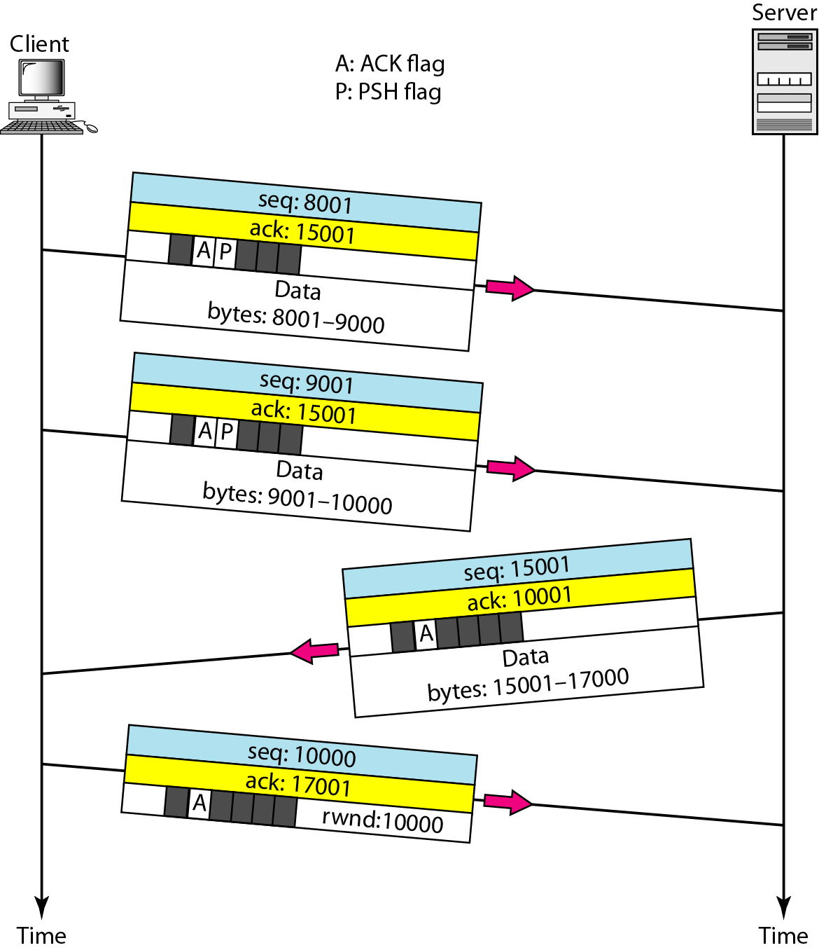
4.1 Transport Layer: Introduction - Services
Data Transfer
After connection is established, bidirectional data transfer can take place. The client and server can both send data and acknowledgments. The acknowledgment is piggybacked with the data.
In the following example shown in figure, after connection is established, the client sends 2000 bytes of data in two segments. The server then sends 2000 bytes in one segment.
The client sends one more segment. The first three segments carry both data and acknowledgment, but the last segment carries only an acknowledgment because there are no more data to be sent.
The data segments sent by the client have the PSH (push) flag set so that the server TCP knows to deliver data to the server process as soon as they are received. The segment from the server, on the other hand, does not set the push flag.
TCP uses a buffer to store the stream of data coming from the sending application program. The sending TCP can select the segment size.
The receiving TCP also buffers the data when they arrive and delivers them to the application program when the application program is ready or when it is convenient for the receiving TCP. This type of flexibility increases the efficiency of TCP.
Figure: Data Transfer in TCP

Slide 16
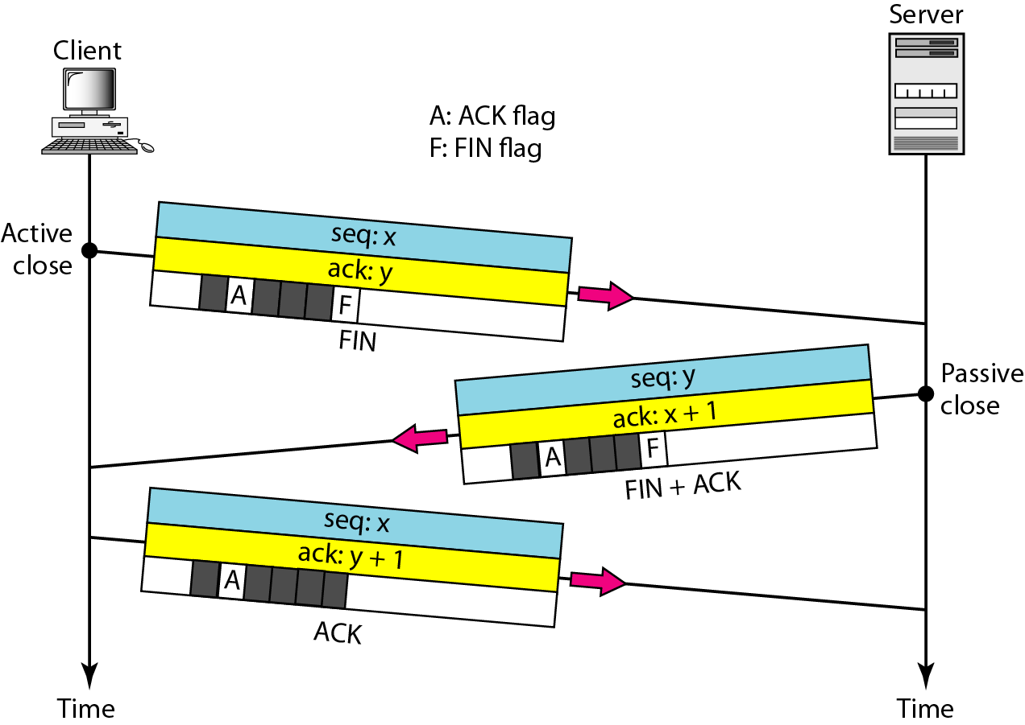
4.1 Transport Layer: Introduction - Services
Connection Termination: Any of the two parties involved in exchanging data (client or server) can close the connection, although it is usually initiated by the client. TCP uses three-way handshaking for connection termination
In a normal situation, the client TCP, after receiving a close command from the client process, sends the first segment, a FIN segment in which the FIN flag is set. Note that a FIN segment can include the last chunk of data sent by the client, or it can be just a control segment.
The server TCP, after receiving the FIN segment, informs its process of the situation and sends the second segment, a FIN +ACK segment, to confirm the receipt of the FIN segment from the client and at the same time to announce the closing of the connection in the other direction. This segment can also contain the last chunk of data from the server. If it does not carry data, it consumes only one sequence number.
The client TCP sends the last segment, an ACK segment, to confirm the receipt of the FIN segment from the TCP server. This segment contains the acknowledgment number, which is 1 plus the sequence number received in the FIN segment from the server. This segment cannot carry data and consumes no sequence numbers.
Figure: Connection Termination using Three way handshake protocol.

Slide 17


4.1.1 Transport Layer: SOCKET PROGRAMMING
What Is a Socket? : Normally, a server runs on a specific computer and has a socket that is bound to a specific port number. The server just waits, listening to the socket for a client to make a connection request.
On the client-side: The client knows the hostname of the machine on which the server is running and the port number on which the server is listening. To make a connection request, the client tries to rendezvous with the server on the server's machine and port. The client also needs to identify itself to the server so it binds to a local port number that it will use during this connection. This is usually assigned by the system.
If everything goes well, the server accepts the connection. Upon acceptance, the server gets a new socket bound to the same local port and also has its remote endpoint set to the address and port of the client. It needs a new socket so that it can continue to listen to the original socket for connection requests while tending to the needs of the connected client.
On the client side, if the connection is accepted, a socket is successfully created and the client can use the socket to communicate with the server.
The client and server can now communicate by writing to or reading from their sockets.

Slide 18
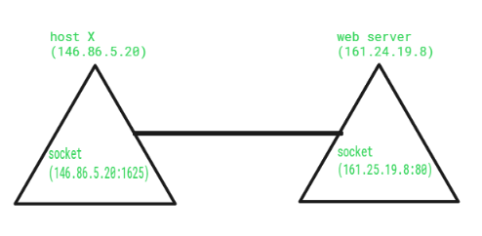
4.1.1 Transport Layer: SOCKET PROGRAMMING
Definition: A socket is one endpoint of a two-way communication link between two programs running on the network. A socket is bound to a port number so that the TCP layer can identify the application that data is destined to be sent to.
An endpoint is a combination of an IP address and a port number. Every TCP connection can be uniquely identified by its two endpoints. That way you can have multiple connections between your host and the server.
The java.net package in the Java platform provides a class, Socket, that implements one side of a two-way connection between your Java program and another program on the network. The Socket class sits on top of a platform-dependent implementation, hiding the details of any particular system from your Java program.
By using the java.net.Socket class instead of relying on native code, your Java programs can communicate over the network in a platform-independent fashion.
Additionally, java.net includes the ServerSocket class, which implements a socket that servers can use to listen for and accept connections to clients. This session shows you how to use the Socket and ServerSocket classes.

Slide 19
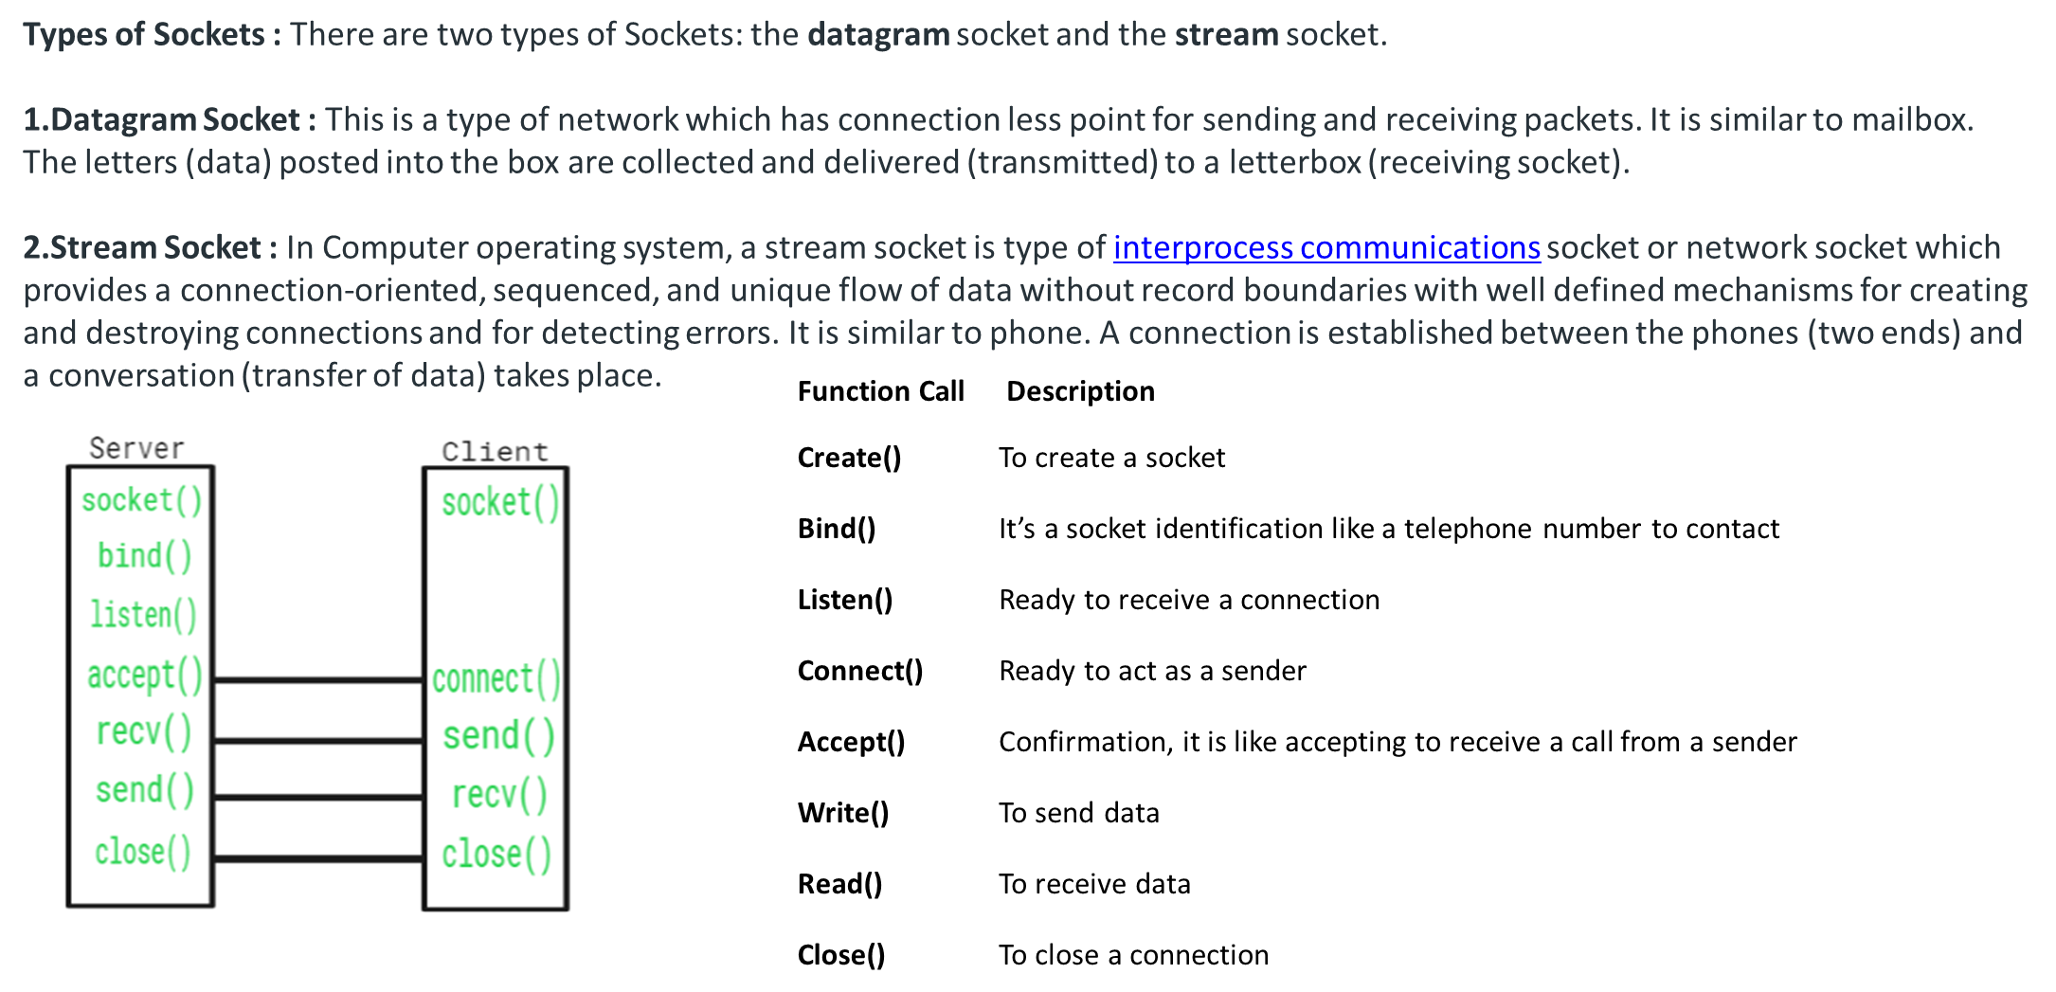
4.1.1 Transport Layer: SOCKET PROGRAMMING

Slide 20
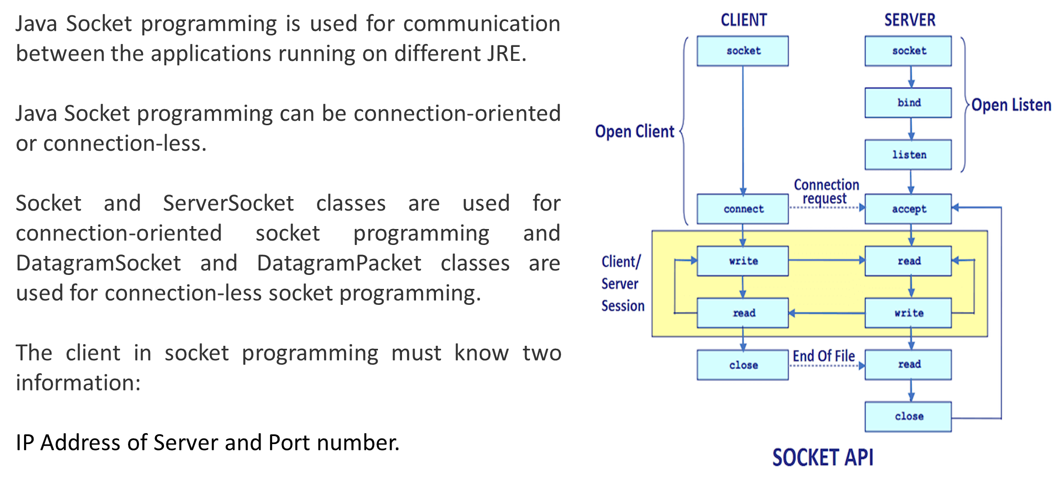
4.1.1 Transport Layer: SOCKET PROGRAMMING

Slide 21
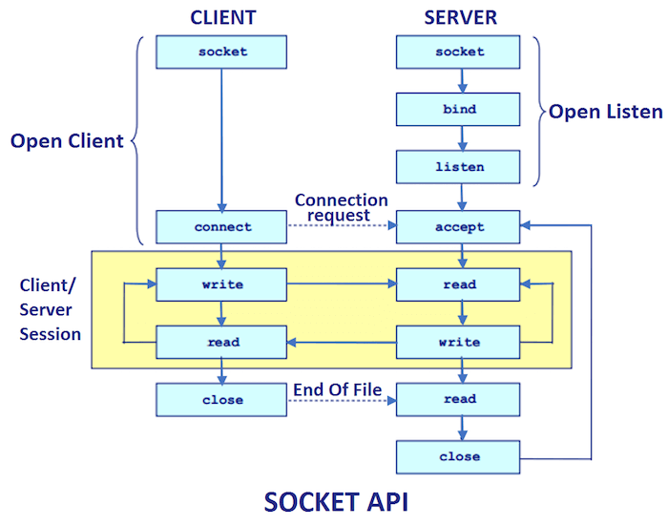
4.1.1 Transport Layer: SOCKET PROGRAMMING

Slide 22
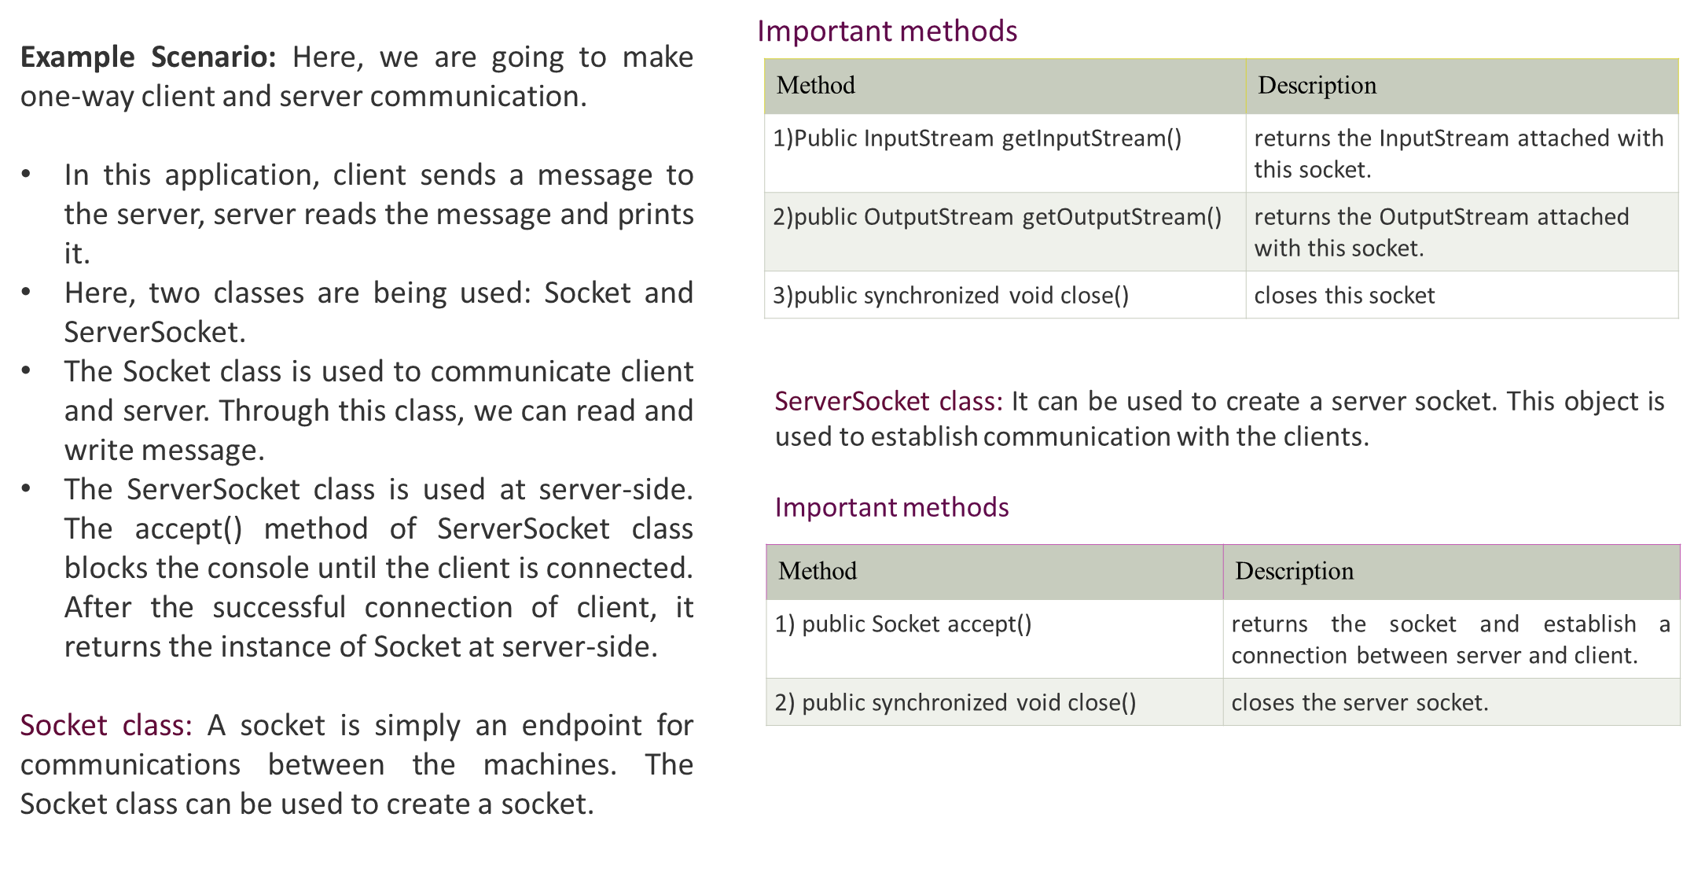
4.1.1 Transport Layer: SOCKET PROGRAMMING

Slide 23
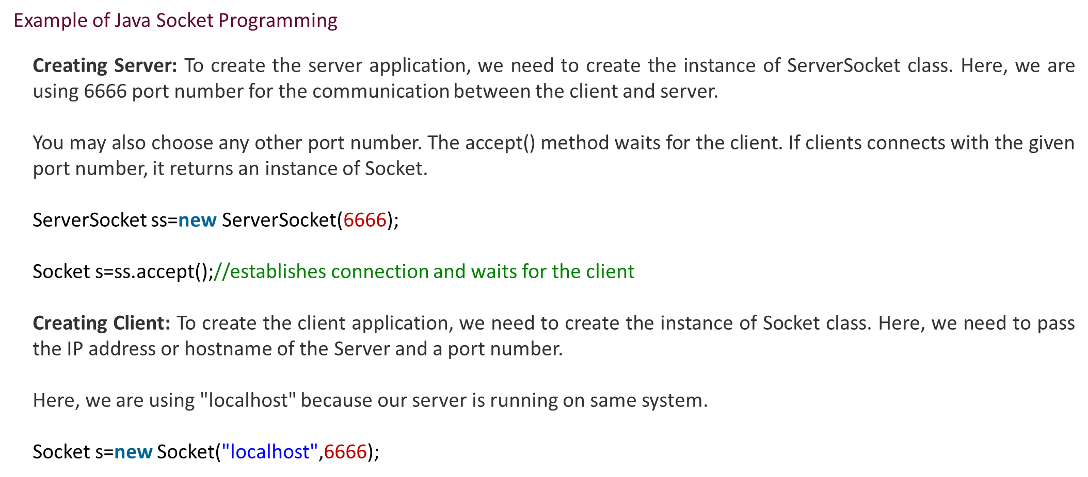
4.1.1 Transport Layer: SOCKET PROGRAMMING

Slide 24
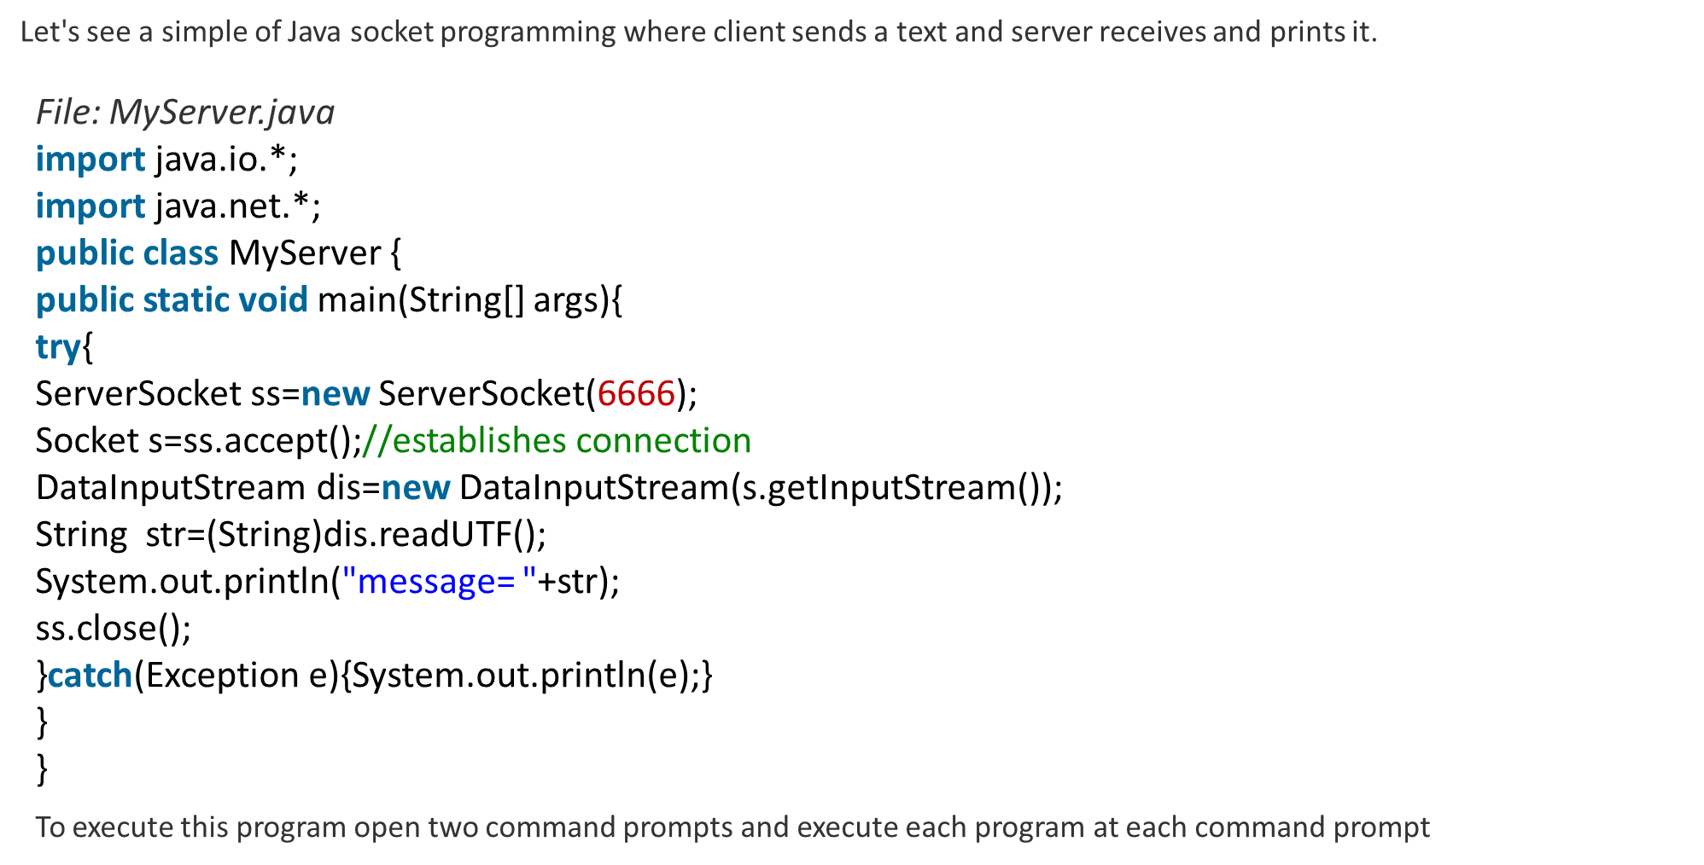
4.1.1 Transport Layer: SOCKET PROGRAMMING

Slide 25
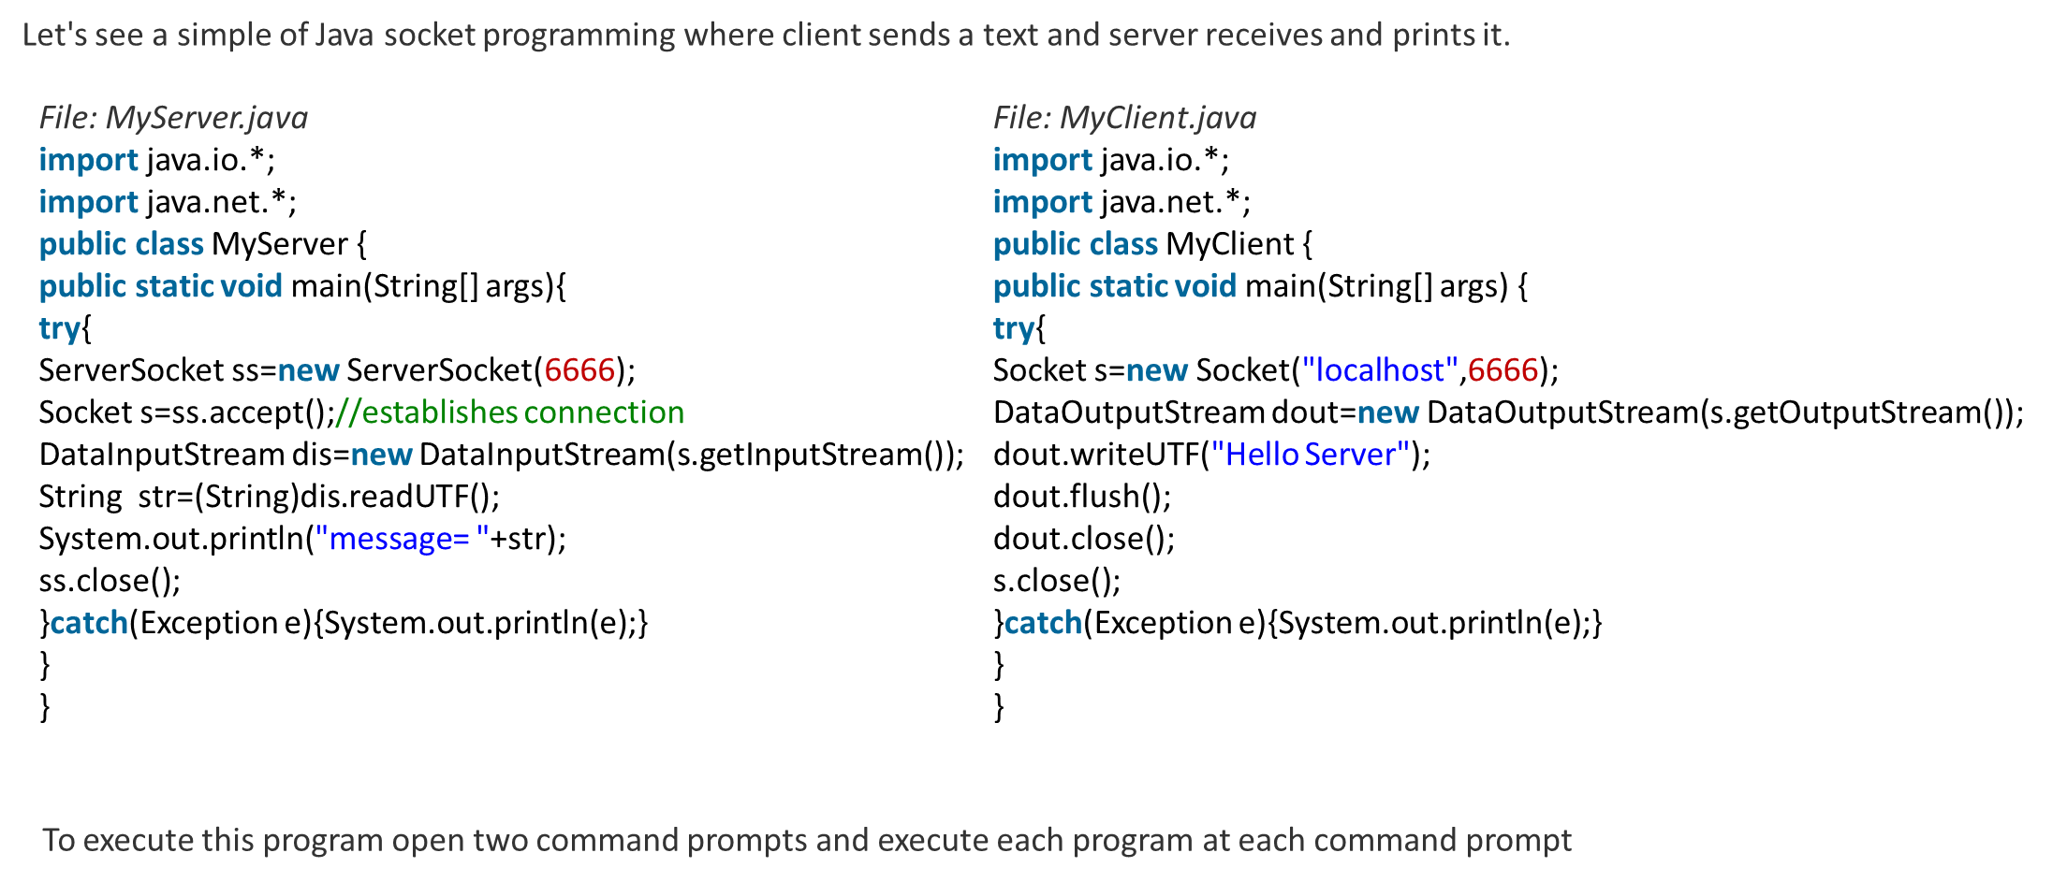
4.1.1 Transport Layer: SOCKET PROGRAMMING

Slide 26
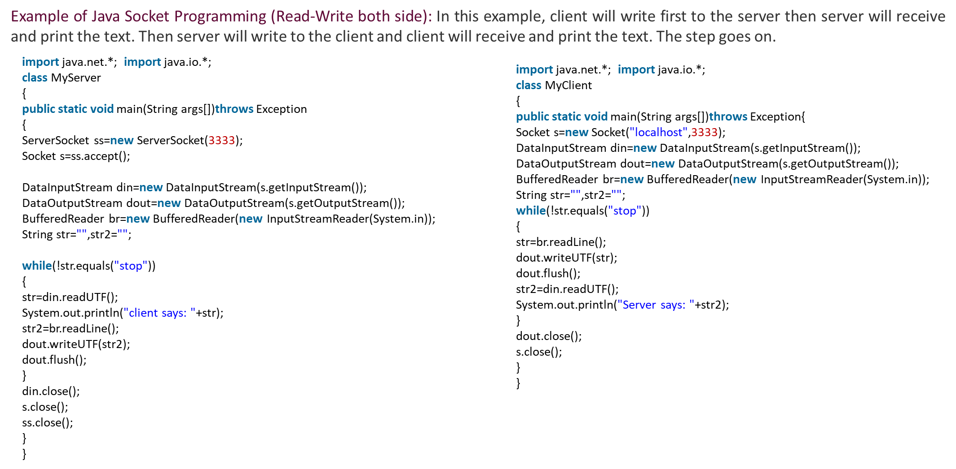
4.1.1 Transport Layer: SOCKET PROGRAMMING

Slide 27
4.2.1 Transport Layer: Elements of transport protocols
Transport protocols, such as TCP (Transmission Control Protocol) and UDP (User Datagram Protocol), are responsible for ensuring reliable and efficient data transmission over a network. Here are some key elements of transport protocols:
Segmentation and Reassembly: Transport protocols divide the data into smaller units called segments or datagrams. This segmentation allows for efficient transmission over the network and enables reassembly of the data at the receiving end.
Connection Establishment and Termination: Transport protocols may provide mechanisms for establishing and terminating connections between communicating hosts. For example, TCP uses a three-way handshake to establish a reliable connection and a four-way handshake to terminate it.
Reliability: Transport protocols, particularly TCP, ensure reliable delivery of data by using acknowledgments, sequence numbers, and retransmissions. They track the segments sent and received, detect missing or lost segments, and request retransmission when necessary.
Flow Control: Transport protocols implement flow control mechanisms to manage the rate of data transmission between the sender and receiver. Flow control prevents overwhelming the receiver with a large amount of data and avoids congestion on the network.
Congestion Control: Congestion control is another important aspect of transport protocols, especially TCP. It regulates the amount of data sent into a network to prevent congestion, ensuring fair and efficient sharing of network resources.
Error Detection and Correction: Transport protocols may include error detection and correction mechanisms to ensure data integrity. For example, TCP employs a checksum to detect errors in the received data and requests retransmission if errors are detected.
Multiplexing and Demultiplexing: Transport protocols allow multiple applications or processes running on a host to share a single network connection. They use port numbers to identify different applications or processes (multiplexing) and route the incoming data to the correct destination (demultiplexing).
Addressing: Transport protocols use addressing schemes, such as IP addresses and port numbers, to identify the source and destination hosts and applications. This addressing allows the delivery of data to the intended recipient.
These elements collectively provide reliable, efficient, and orderly transmission of data across networks, enabling applications to communicate effectively over the Internet and other computer networks.

Slide 28
4.2.1 Transport Layer: Elements of transport protocols
Transport protocols, such as TCP (Transmission Control Protocol) and UDP (User Datagram Protocol), are responsible for ensuring reliable and efficient data transmission over a network. Here are some key elements of transport protocols:
Segmentation and Reassembly: Transport protocols divide the data into smaller units called segments or datagrams. This segmentation allows for efficient transmission over the network and enables reassembly of the data at the receiving end.
Connection Establishment and Termination: Transport protocols may provide mechanisms for establishing and terminating connections between communicating hosts. For example, TCP uses a three-way handshake to establish a reliable connection and a four-way handshake to terminate it.
Reliability: Transport protocols, particularly TCP, ensure reliable delivery of data by using acknowledgments, sequence numbers, and retransmissions. They track the segments sent and received, detect missing or lost segments, and request retransmission when necessary.
Flow Control: Transport protocols implement flow control mechanisms to manage the rate of data transmission between the sender and receiver. Flow control prevents overwhelming the receiver with a large amount of data and avoids congestion on the network.
Congestion Control: Congestion control is another important aspect of transport protocols, especially TCP. It regulates the amount of data sent into a network to prevent congestion, ensuring fair and efficient sharing of network resources.
Error Detection and Correction: Transport protocols may include error detection and correction mechanisms to ensure data integrity. For example, TCP employs a checksum to detect errors in the received data and requests retransmission if errors are detected.
Multiplexing and Demultiplexing: Transport protocols allow multiple applications or processes running on a host to share a single network connection. They use port numbers to identify different applications or processes (multiplexing) and route the incoming data to the correct destination (demultiplexing).
Addressing: Transport protocols use addressing schemes, such as IP addresses and port numbers, to identify the source and destination hosts and applications. This addressing allows the delivery of data to the intended recipient.
These elements collectively provide reliable, efficient, and orderly transmission of data across networks, enabling applications to communicate effectively over the Internet and other computer networks.

Slide 29
4.2.1 Transport Layer: Elements of transport protocols
Multiplexing and demultiplexing are important elements of transport layer protocols, such as TCP and UDP. They allow multiple applications or processes on a single host to share a network connection and ensure that data is delivered to the correct destination.
Multiplexing:
Source Port: When an application sends data using a transport layer protocol, it associates the data with a specific source port number. The source port is an identifier that represents the sending application or process on the host. It helps to differentiate between multiple applications running simultaneously on the same host.
Destination Port: The destination port represents the intended recipient application or process on the receiving host. It is a port number that identifies the specific application or service to which the data should be delivered.
Header Information: The transport layer protocol adds a header to the data segment that includes the source port and destination port numbers. This header information allows the receiving host to correctly identify the application or process to which the data should be delivered.
Demultiplexing:
Destination Port Matching: When a data segment arrives at a host, the transport layer protocol examines the destination port number in the header. It compares the destination port with a list of active ports on the receiving host to identify the application or process that should receive the data.
Delivering Data to the Correct Application: Once the receiving host determines the correct destination port, it delivers the data segment to the corresponding application or process associated with that port.
By using multiplexing and demultiplexing, transport layer protocols enable multiple applications on a host to share a single network connection. The combination of the source and destination port numbers ensures that data is routed to the correct application or process, facilitating effective communication between applications across the network.

Slide 30
4.3.1 The internet transport protocols : UDP
UDP (User Datagram Protocol) is one of the core transport protocols in the Internet Protocol Suite (TCP/IP). Unlike TCP, which provides reliable and ordered data delivery, UDP is a connectionless and unreliable protocol. It offers a lightweight and efficient way to transmit data between hosts in a best-effort manner. Here's an overview of UDP, along with its uses in remote procedure call (RPC) and real-time transport.
Introduction to UDP: UDP is a simple protocol that operates at the transport layer of the TCP/IP model. It provides a minimal set of features compared to TCP, making it faster and more lightweight. Some key characteristics of UDP include:
Connectionless: UDP does not establish a dedicated connection between the sender and receiver before transmitting data. Each UDP datagram is independent and can take a different path through the network.
Unreliable: UDP does not guarantee reliable delivery of data. It does not provide mechanisms for retransmission, flow control, or error recovery. Packets may be lost, duplicated, or delivered out of order.
Low Overhead: UDP has minimal header information, requiring fewer computational and network resources compared to TCP. This makes it suitable for applications with lower latency requirements or where error recovery mechanisms are handled at higher layers.
Uses of UDP:
Remote Procedure Call (RPC): RPC is a mechanism for interprocess communication between different applications or processes running on separate hosts. UDP is often used as the underlying transport protocol for RPC frameworks, such as the Network File System (NFS) or the Lightweight Directory Access Protocol (LDAP). UDP's simplicity and lower overhead make it a good choice for RPC scenarios where speed is prioritized over reliability.
Real-Time Transport Protocols: UDP is commonly used in real-time applications that require low latency and efficient data transmission. Examples include real-time audio and video streaming, online gaming, VoIP (Voice over Internet Protocol), and IoT (Internet of Things) applications. These applications benefit from UDP's low overhead and reduced latency, even though some data loss or out-of-order delivery may occur.
UDP is suitable for scenarios where a small amount of data loss or occasional inconsistencies in transmission are acceptable. It is often paired with application-layer mechanisms to handle error recovery, reliability, and sequencing, if required.
However, due to UDP's unreliable nature, applications built on top of UDP must implement their own error detection, retransmission, and flow control mechanisms if reliability is critical. Alternatively, applications can opt for TCP, which provides reliable and ordered delivery at the cost of higher overhead and potential increased latency.

Slide 31
4.4.1 The internet transport protocols : TCP
TCP (Transmission Control Protocol) is a reliable and connection-oriented transport protocol widely used in the Internet Protocol Suite (TCP/IP). It provides a reliable, ordered, and error-checked delivery of data between hosts. Let's explore the key aspects of TCP, including its service model, segment header, connection management, sliding window and timer management, and congestion control.
Introduction to TCP: TCP is designed to ensure reliable data transmission across IP networks. It offers a set of features that enable applications to send and receive data with guarantees of delivery and order. Some important characteristics of TCP include:
Connection-Oriented: TCP establishes a connection between the sender and receiver before transmitting data. This connection is established using a three-way handshake, where both sides exchange control messages to synchronize sequence numbers and establish communication parameters.
Reliable Delivery: TCP guarantees reliable data delivery by using acknowledgments (ACKs) and sequence numbers. It ensures that all data sent by the sender is received correctly by the receiver. If any segments are lost or corrupted during transmission, TCP will retransmit them.
Ordered Delivery: TCP maintains the order of data segments during transmission. It ensures that data is received by the receiver in the same order it was sent by the sender.
Flow Control: TCP implements flow control mechanisms to manage the rate of data transmission between the sender and receiver. It prevents overwhelming the receiver with a large amount of data by dynamically adjusting the transmission rate based on the receiver's ability to handle the data.
Congestion Control: TCP incorporates congestion control mechanisms to avoid network congestion. It adjusts the transmission rate based on network conditions, such as packet loss or increased delay, to ensure fair and efficient sharing of network resources.
TCP Service Model, Protocol, Segment Header: The TCP service model revolves around providing reliable and ordered data transfer. It ensures that all data is received correctly and in the correct order by the receiver. TCP achieves this through the following:
TCP Protocol: TCP uses a set of rules and procedures to establish, maintain, and terminate connections between hosts. It defines how data is segmented, transmitted, and reassembled at the receiving end.
TCP Segment Header: Each TCP segment contains a header that carries control information necessary for reliable data delivery. The header includes source and destination port numbers, sequence numbers, acknowledgment numbers, control flags, window size, checksum, and other fields.

Slide 32
4.4.2 TCP Connection Management
TCP Connection Management and Release: TCP employs a connection-oriented approach for communication. The connection management process includes:
Three-Way Handshake: Before data transmission, TCP establishes a connection using a three-way handshake. The client sends a SYN (synchronize) segment to the server, the server responds with a SYN-ACK (synchronize-acknowledgment) segment, and finally, the client acknowledges the server's response with an ACK segment.
Connection Release: When the data transfer is complete, TCP initiates a connection release process. It uses a four-way handshake to ensure the orderly termination of the connection.
TCP Sliding Window and Timer Management: The sliding window mechanism is used by TCP for flow control and reliable data transmission. It determines the amount of data that can be transmitted before receiving an acknowledgment. TCP also employs timers to manage various aspects of the connection, including retransmissions, acknowledgment delays, and idle connections.
TCP Congestion Control: TCP implements congestion control mechanisms to avoid network congestion and ensure fair sharing of network resources. It uses various algorithms, such as slow start, congestion avoidance, and fast retransmit, to dynamically adjust the transmission rate based on network conditions. TCP monitors packet loss, round-trip times, and network congestion signals to regulate the amount of data sent into the network.
These elements collectively make TCP a reliable and widely used transport protocol for various applications that require guaranteed delivery and ordered data transfer over IP networks.

Slide 33
Assessments
Written Test: Prepare a written test consisting of multiple-choice questions, true/false statements, and short answer questions. The questions can cover various topics, such as the services provided by the transport layer, transport service primitives, socket programming, addressing, connection establishment and release, error control and flow control, multiplexing and crash recovery, and specific aspects of UDP and TCP protocols.
Practical Exercises: Assign practical exercises to assess the participants' understanding and application of the concepts. For example, you can provide a scenario where participants need to design and implement a simple client-server application using socket programming. Evaluate their solutions based on the correctness of the implementation, adherence to protocol specifications, and error handling.
Group Presentations: Divide participants into groups and assign each group a specific topic from the content. Ask them to prepare a presentation discussing the key concepts, working principles, and practical implications of the assigned topic. Evaluate their presentations based on the clarity of explanations, depth of understanding, and ability to answer questions from the audience.
Case Study Analysis: Provide participants with a case study related to transport layer protocols, such as a scenario involving network congestion, application requirements, or protocol selection. Ask them to analyze the case study and propose appropriate solutions or recommendations based on their understanding of the content. Evaluate their analysis based on the relevance of the proposed solutions and the ability to justify their choices.
Simulation or Lab Exercises: Conduct hands-on lab exercises or simulations using network simulation tools or software-defined networking (SDN) environments. Participants can be tasked with configuring and managing transport layer protocols, addressing, connection establishment, congestion control, or other relevant aspects. Assess their performance based on the accuracy of the configurations, ability to troubleshoot and resolve issues, and understanding of the underlying concepts.
Open-Ended Questions: Provide open-ended questions that require participants to think critically and express their understanding of the content in their own words. For example, you can ask them to explain the significance of addressing in transport protocols, discuss the trade-offs between UDP and TCP for specific applications, or propose improvements to the TCP congestion control mechanism. Assess their responses based on the depth of understanding, logical reasoning, and clarity of explanations.
These assessment methods provide a variety of formats to evaluate participants' knowledge, understanding, and application of the concepts related to transport layer services, protocols, and their management.

Slide 34
Activities
Group Discussion: Divide the participants into small groups and assign each group one of the topics from the content. In their groups, they can discuss and brainstorm the key aspects, advantages, and challenges associated with the assigned topic. Each group can then present their findings to the larger group for further discussion and analysis.
Case Study Analysis: Provide the participants with a case study scenario that involves transport layer services, elements of transport protocols, or specific protocols like UDP or TCP. Ask them to analyze the case study, identify the relevant concepts, and propose appropriate solutions or recommendations based on their understanding of the content.
Socket Programming Exercise: Introduce participants to socket programming and its role in communication using TCP or UDP. Assign them programming tasks to develop simple client-server applications that demonstrate different aspects of socket programming, such as establishing connections, sending/receiving data, and handling errors or timeouts.
Role Play: Organize a role-playing activity where participants assume different roles, such as a transport layer protocol designer, an application developer, or a network administrator. Encourage them to engage in discussions or debates, considering the various elements of transport protocols, service models, and their implications on real-world scenarios. This activity can enhance their understanding of the content by exploring different perspectives.
Protocol Comparison Chart: Create a comparison chart that outlines the key differences and similarities between UDP and TCP. Distribute the chart to participants and ask them to fill in the details based on their understanding of the content. Discuss the completed charts as a group, allowing participants to share their insights and clarify any misconceptions.
Simulation Exercise: Use a network simulation tool to simulate different transport layer scenarios, such as connection establishment, error control, or congestion control. Ask participants to observe and analyze the behavior of UDP and TCP in these scenarios. They can document their observations, discuss the results, and draw conclusions about the strengths and weaknesses of each protocol.
These activities provide a mix of group discussions, practical exercises, and analysis, allowing participants to engage actively with the content and reinforce their understanding of transport layer services, protocols, and their management.

Slide 35
Did You Know?
Did you know that the transport layer provides services to the upper layers of the network protocol stack, such as reliable data delivery, ordering of data segments, and flow control?
Did you know that transport service primitives are the basic operations or functions offered by the transport layer to the upper layers, including functions like sending data, receiving data, establishing connections, and releasing connections?
Did you know that socket programming allows applications to communicate over a network by using sockets, which are endpoints for sending and receiving data? It provides a convenient and flexible way for applications to interact with the transport layer.
Did you know that addressing in transport protocols involves identifying the source and destination hosts or processes participating in the communication? It plays a crucial role in establishing communication paths and routing data correctly.
Did you know that shortest path routing and flooding are two different routing techniques used in transport protocols? Shortest path routing finds the most efficient path based on predefined metrics, while flooding broadcasts data to all connected hosts.
Did you know that connection establishment is a process in transport protocols where a connection is established between two hosts before data transfer can occur? It involves a series of handshaking steps to synchronize communication parameters.
Did you know that connection release is the process of terminating a connection in transport protocols? It ensures the orderly termination of the connection between the sender and receiver.
Did you know that error control and flow control mechanisms in transport protocols ensure reliable and efficient data transmission? Error control detects and corrects errors in transmitted data, while flow control manages the rate of data transmission to prevent congestion and data loss.
Did you know that multiplexing allows multiple logical connections to share a single physical network connection? It enables efficient utilization of network resources and supports concurrent communication between multiple hosts.
Did you know that crash recovery mechanisms in transport protocols help recover from system failures or crashes? These mechanisms ensure the continuity of communication and the restoration of lost data or connections.
Did you know that UDP (User Datagram Protocol) is a lightweight transport protocol that provides low overhead and minimal reliability features? It is commonly used for applications where low latency and real-time communication are crucial.
Did you know that remote procedure call (RPC) is a mechanism that allows a program on one host to invoke procedures on a remote host? UDP can be used as the underlying transport protocol for implementing RPC.
Did you know that real-time transport protocols are designed to support time-sensitive applications, such as streaming media, online gaming, and voice/video communication? These protocols prioritize timely delivery of data to ensure a smooth and uninterrupted user experience.
Did you know that TCP (Transmission Control Protocol) is a reliable and connection-oriented transport protocol widely used on the internet? It provides guaranteed delivery, data ordering, and congestion control mechanisms for reliable communication.
Did you know that the TCP segment header contains various fields, including source and destination port numbers, sequence numbers, acknowledgment numbers, control flags, and window size? These fields are used for reliable data transmission and connection management.
Did you know that TCP employs connection management mechanisms, such as the three-way handshake, to establish and release connections between hosts? These mechanisms ensure reliable and synchronized communication.
Did you know that TCP sliding window and timer management play a crucial role in flow control and efficient data transmission? The sliding window mechanism determines the amount of data that can be transmitted, while timers help manage retransmissions and connection timeouts.
Did you know that TCP congestion control mechanisms aim to regulate the transmission rate to avoid network congestion? These mechanisms dynamically adjust the transmission rate based on network conditions to ensure fair sharing of network resources.

Slide 36
Terminal Questions
What are the main services provided by the transport layer to the upper layers of the network protocol stack?
Explain the concept of transport service primitives and provide examples of commonly used primitives.
Describe the key features and benefits of socket programming in the context of network communication.
How does addressing work in the context of transport protocols? Discuss the importance of addressing in establishing communication between hosts.
Compare and contrast shortest path routing and flooding as routing techniques used in transport protocols. What are the advantages and disadvantages of each?
Explain the process of connection establishment in transport protocols. What are the steps involved, and why is it necessary?
Discuss the various factors and mechanisms involved in connection release in transport protocols. What considerations should be taken into account during the release process?
Describe the role of error control and flow control in transport protocols. How do these mechanisms ensure reliable and efficient data transmission?
Explain the concept of multiplexing in the context of transport protocols. How is it used to handle multiple concurrent connections?
Discuss the importance of crash recovery in transport protocols. What strategies and mechanisms are used to recover from system failures or crashes?
Provide an introduction to UDP (User Datagram Protocol). What are its main characteristics and use cases?
Explain the concept of remote procedure call (RPC) and how it is facilitated using UDP as the transport protocol.
Describe real-time transport protocols and their significance in applications such as streaming, gaming, and VoIP (Voice over Internet Protocol).
Provide an introduction to TCP (Transmission Control Protocol). What is its service model, and how does it differ from UDP?
Discuss the components of the TCP segment header and explain the purpose of each field.
Explain the process of TCP connection management and release. How does TCP establish and terminate connections between hosts?
Describe the sliding window mechanism used in TCP for flow control and efficient data transmission. How does it contribute to reliable communication?
Discuss TCP congestion control and its importance in managing network congestion. Explain the algorithms and techniques used to regulate the transmission rate.

Slide 37

Summary
Outcomes:
Students will gain a deep understanding of the transport layer's role in the network protocol stack. They will learn how it facilitates communication between applications running on different hosts by providing reliable and efficient data delivery services.
Students will become familiar with the services provided by the transport layer to the upper layers. They will learn about the importance of reliable data transfer, flow control, error control, multiplexing, and connection management in ensuring smooth and efficient communication.
Students will gain a comprehensive understanding of the different transport protocols, including UDP and TCP. They will learn about the characteristics, advantages, and use cases of each protocol, enabling them to make informed decisions when selecting the appropriate protocol for specific applications.
Students will be introduced to socket programming, which is a fundamental skill for network application development. They will learn how to create client-server applications using socket APIs, enabling them to design and implement networked applications that leverage the services of the transport layer.
Students will develop analytical skills through the study of transport layer elements such as addressing, routing, connection establishment, connection release, error control, and flow control. They will learn how to analyze network scenarios, identify potential issues, and propose solutions to ensure reliable and efficient communication.
Students will acquire troubleshooting and problem-solving skills specific to transport layer issues. They will learn how to diagnose and resolve problems related to connection establishment, congestion control, error recovery, and other transport layer mechanisms.

Slide 38
Reference Links
Reference Material
Computer Networks -- Andrew S Tanenbaum, David. j. Wetherall, 5th Edition. Pearson Education/PHI
An Engineering Approach to Computer Networks-S. Keshav, 2nd Edition, Pearson Education
Data Communications and Networking – Behrouz A. Forouzan. Third Edition TMH.
Behrouz A. Forouzan (2006), Data communication and Networking, 4th Edition, Mc Graw Hill, India.
Kurose, Ross (2010), Computer Networking: A top-down approach, Pearson Education, India Put your link here.

Slide 39
Thank you

